Slide 1
Module 3: Advanced ALP

Slide 2
What are interrupts?
What would you do when you get a WhatsApp message when you are listening to a lecture?
Which interrupt would you choose?
Knock on the door or a phone call?
Interrupts have priority
Some interrupts are more important than the other

Slide 3
Definition of Interrupts
Used to break the sequence of operation.
While the CPU is executing a program, an ‘interrupt’ breaks the normal sequence of execution of instructions, diverts its execution to some other program called Interrupt Service Routine(ISR).
After executing ISR , the control is transferred back again to the main program.

Slide 4
Need for Interrupt
Interrupts are particularly useful when interfacing I/O devices that provide or require data at relatively low data transfer rate.

Slide 5
Sources of Interrupts in 8086
.
An external signal applied to NMI or INTR input Pin→ Hardware interrupt
Execution of Interrupt instruction → Software interrupt
Interrupt due to error condition produced in 8086 instruction execution process (divide by zero, overflow errors)

Slide 6
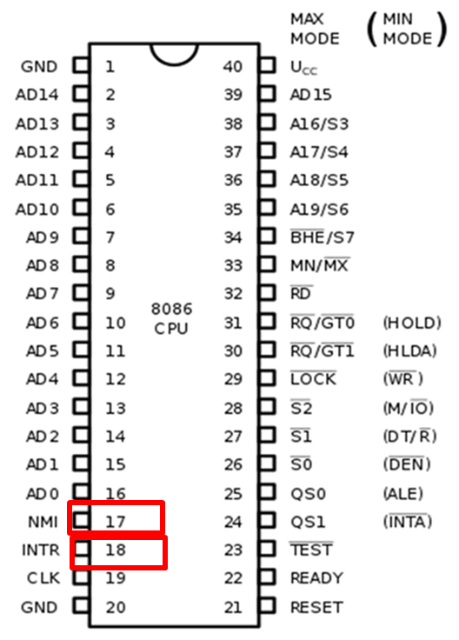
Hardware Interrupts(External interrupt)
caused by any peripheral device by sending a signal through a specified pin to the microprocessor.
Two hardware interrupt pins: INTR and NMI. One more interrupt pin associated is INTA called interrupt acknowledge
Interrupt
Hardware interrupt
Maskable interrupt
Non maskable interrupt

Slide 7
Hardware Interrupts(External interrupt)
NMI- Non Maskable Interrupt
Any interrupt request at NMI input cannot be masked/disabled by any means.
higher priority than the maskable interrupt request pin (INTR) and it is of type 2 interrupt.
INTR- Maskable Interrupt
It is a maskable interrupt, because it will be masked using Interrupt flag(IF).
Activated by an I/O port.

Slide 8
Software interrupts
Inserted at the desired position into the program to create interrupts.
INT- Interrupt instruction with type number.
INTR is of 256 types and it may be from 00 to FFH or (00 to 255)

Slide 9
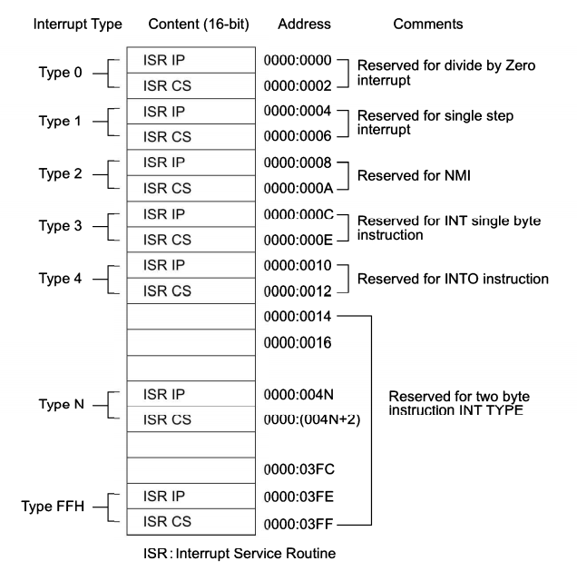
INTERRUPT VECTOR TABLE
It is crucial to an understanding of hardware and software interrupts.
Reserved 1024 loactions for storing the interrupt vector table.
8086 supports 256 type of interrupts.(00 to FFH).
Each interrupt need 4 bytes. i.e 2 bytes each for IP and CS of its ISR
Int type x 4= gives offset address in Zeroth code segment at which IP and CS addresses of ISR are stored.

Slide 10
TYPE 0 :
The divide error whenever the result from a division overflows or an attempt is made to divide by zero.
ISR is responsible for displaying the message “Divide Error” on the screen
INT 01
Single step or trap occur if the trap flag is set to 1.
Upon accepting this interrupt, the TF bit is cleared so that the interrupt service procedure executes at full speed.

Slide 11
TYPE 2
Non-maskable interrupt occurs when a logic 1 is placed on the NMI input pin to the microprocessor.
This input is non-maskable, which means that it cannot be disabled.
TYPE 3 :
A special one-byte instruction (INT 3) that uses this vector to access its interrupt service procedure.
The INT 3 instruction is often used to store a breakpoint in a program for debugging.
TYPE 4:
Overflow is a special vector used with the INTO instruction.
The INTO instruction interrupts the program if an overflow condition exists, as reflected by the overflow flag (OF).

Slide 12
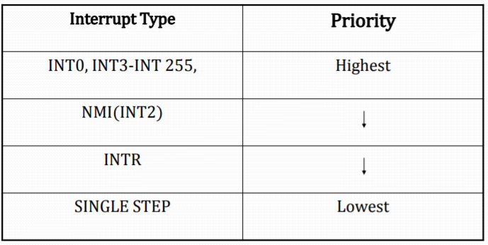
PRIORITY OF INTERRUPTS

Slide 13
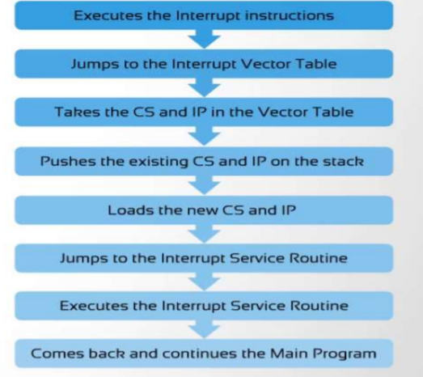
Steps involved in processing an interrupt instruction by the processor

Slide 14
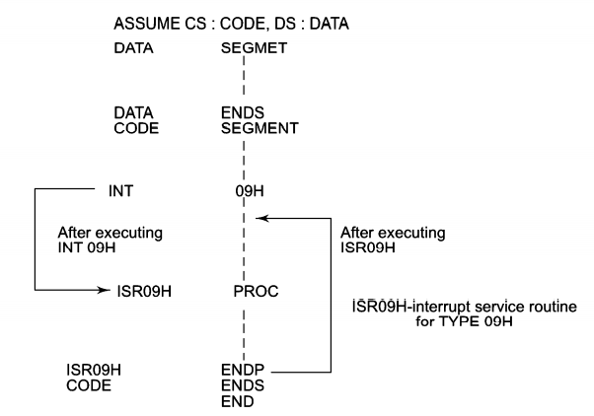
INTERRUPT PROGRAMMING

Slide 15
DOS and BIOS interrupts
Used to perform some very useful functions, such as displaying data to monitor, reading data from keyboard.
Used by identifying the interrupt option type, which is the value stored in register AH.

Slide 16
DOS Interrupts 21H
When MS-DOS is loaded in the computer INT 21H is used to provide an interrupt to perform some important functions.
These are called DOS INT 21H function calls.
Main function calls are data input/output through keyboard
Example:
Option 1- Input a single character from keyboard
Register used:
AH=1
AL= the character inputted from keyboard
Ex:
MOV AH, 01 – option to input one character
INT 21H -invoke interrupt

Slide 17
DOS Interrupts 21H
Option 2- output a single character to the monitor
Register used:
AH =2
DL = character to be displayed
EX:
MOV AH, 2
MOV DL, ‘A’
INT 21H

Slide 18
DOS Interrupts 21H
Option 9: output a string of data terminated by $ to the monitor.
Register used:
AH=9
DX = offset address of data to be displayed
Ex:
MOV AH,09 ;option 9 to display string of data
MOV DX, OFFSET mess1
INT 21H ; invoke the interrupt

Slide 19
DOS Interrupts 21H
Option 0AH: Input a string of data from the keyboard
Register used:
AH=0AH
DX = offset address of location where string will be stored
Ex:
.DATA
BUFFER1 DB 15,? 15 DUP(FF)
MOV AH,0AH ;
MOV DX, OFFSET Buffer1
INT 21H ;

Slide 20
DOS Interrupts 21H
Option 4CH: Terminate a process, by returning control to a parent process or to DOS.
Register used:
AH=4CH
AL= binary return code
Ex:
MOV AH,4CH ;
INT 21H ;

Slide 21
BIOS Interrupts
The INT 10H BIOS of the 8086 are used to communicate with the user through the screen.
Manipulation of screen text is done through INT 10H
Example → changing colors of characters, background, changing cursor locations, clearing screen.

Slide 22
BIOS Interrupts 10H
It Controls The Video Display
Function Call 00: Select Video Mode
Input Parameter:
AH = 00H
AL = Mode Number
Function: It Changes The Display Mode And Clears The Screen
AL = 00 40 X 25 Black And White
AL = 04 320 X 200 Color
AL= 10 640 X 350 X 16 Color

Slide 23
BIOS Interrupts 10H
FUNCTION CALL 03: READ CURSOR POSITION
Input Parameter: AH = 03
BH = Page Number
Function: Reads Cursor Position On Screen
Output Parameters:
CH = Starting Line
CL = Ending Line
DH = Current Row
DL = Current Column

Slide 24
BIOS Interrupts 10H
FUNCTION CALL 2H: set the CURSOR to a specific location
Input Parameter: AH = 2H
BH = 0H select page 0
DH= Row position
DL= Column Position
EX:
MOV AH, 2
MOV BH,0
MOV DH, 12
MOV DL, 39
INT 10H

Slide 25
File Management using MS DOS
File management is very important as far as an operating system (OS) is concerned because it is responsible for creation, storage, changing and deletion of important files and file systems.
The disk operating system (DOS) takes care of the file management in any OS.
Let us see some of the file management procedures that Microsoft DOS (MS DOS) handles.

Slide 26
File Processing Functions
INT 21h provides a group of functions called file handle functions.
These functions make file operations much easier than the file control block method used before.
In the latter, the programmer was responsible for setting a table that contained information about open files.
With file handle functions, DOS keeps track of open file data in its own internal tables, thus relieving the programmer of this responsibility.

Slide 27
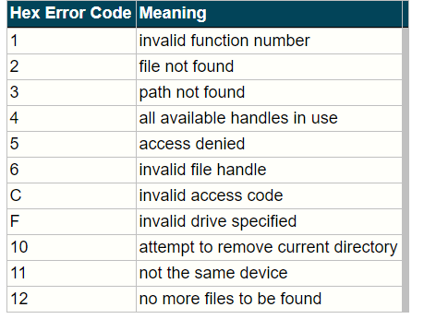
File Errors
There is many opportunities for errors in INT 21h file handling;
DOS identifies each error by a code number.
If an error occurred then CF is set and the code number appears in AX.

Slide 28
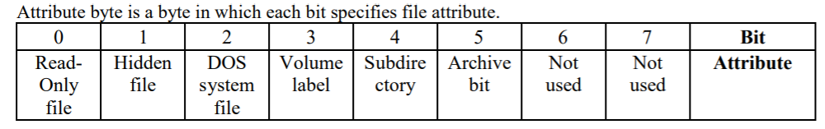
Open a new file
Open a New File/Rewrite a File: INT 21h, function 3Ch
To create a new file or rewrite an existing file, the user provides a file name and an attribute; DOS return a file handle.
Input: AH = 3Ch
DS:DX = address of file name, which is an ASCII string
CL = attribute byte
Output: if successful, AX = file handle
Error if CF = 1, error code in AX (3, 4, or 5)

Slide 29
Open an exixting file
Open an Existing File: INT 21h, function 3Dh
Input: AH = 3Dh
DS:DX = address of file name, which is an ASCII string
AL = access code: 0 means open for reading
1 means open for writing
2 means open for both
Output: if successful, AX = file handle
Error if CF = 1, error code in AX (2, 4, 5 or 12)

Slide 30
CLOSING A FILE
After a file is processed, it should be closed. This frees the file handle for use with another file.
Close a File: INT 21h, function 3Eh
Input: BX = file handle
Output: if CF = 1, error code in AX (6)

Slide 31
Reading from a File
The following function reads a specified number of bytes from a file and stores them in memory.
Read from a File: INT 21h, function 3Fh
Input: AH = 3Fh
BX = file handle
CX = number of bytes to read
DS:DX = memory buffer address
Output: AX = number of bytes actually read
if AX=0 or AX < CX, end of file encountered
Error if CF = 1, error code in AX (5, 6)

Slide 32
Writing to a File
Function 40h writes a specified number of bytes to a file
Write to a File: INT 21h, function 40h
Input: AH = 40h
BX = file handle
CX = number of bytes to write
DS:DX = data address
Output: AX = number of bytes written
if AX=0 or AX < CX, error (full disk)
Error if CF = 1, error code in AX (5, 6)
Function 40h writes data to a file, but it can also be used to send data to the screen or printer (handles 1 and 4 respectively).

Slide 33
Example: Use function 40h to display a message on the screen.
.data
MSG DB 'Display This Message'
...
.code
...
MOV AX, 40h ; write file function
MOV BX, 1 ; screen file handle
MOV CX, 20 ; length of message
LEA DX, MSG ; get address of MSG
INT 21H ; display MSG
...

Slide 34
THANK YOU

